Slide 1

Microsoft Azure Workshop
David Gristwood
David.Gristwood@microsoft.com
@ScroffTheBad

Slide 2



Agenda…
10:00 Welcome + Azure overview | David Gristwood | 30 mins
10:30 Big data | Andrew Fryer | 45 mins
11:15 Power BI | John Donnelly | 30 mins
(11:45 – 12:15 Coffee) |  | 30 mins
12:15 Azure Functions | Will Eastbury | 30 mins
12:45 Working with DX | Nathan Adabadze | 15 mins
(1pm - 2pm Lunch) |  | 1 hour
2pm Security Masterclass | John Craddock | 2.5 hours
(End 4:30 or so)
#msdevuk #azure
vipazure@microsoft.com
https://aka.ms/azureidentityms
https://github.com/dxuk/
AzureWorkshops
Notes:
Also if cannot use the storage account can still repo demos by using the emulator: https://azure.microsoft.com/en-us/documentation/articles/storage-use-emulator/

Slide 3
What’s next….
More strongly themed Azure workshops
Data on Azure – 15th Feb
The Intelligent Cloud ft Bots masterclass – 14th March
Azure “best practices” workshops
Management, Control and Sizing – 31st Jan
Implementing Security and Identity in the Cloud – Feb 23rd
Webinar series
Getting Started on Azure - Jan 24th, Feb 7th, March 7th
Bots and Conversation as a Platform - Jan 26th
Machine Learning - Feb 21st
Azure Functions & Serverless Computing - March 16th
email vipazure@microsoft.com

Slide 4
Power BI Embedded Workshop
Invite only
25th – 27th January 2017, Microsoft Reading
3 days of coding with Microsoft on your own data
Applications - https://aka.ms/i1f6ld - by COB Friday 13th Jan

Slide 5

https://pollev.com/ukdx
Notes:
https://www.polleverywhere.com/multiple_choice_polls/tB2ywb8sXljcKpp

Slide 6
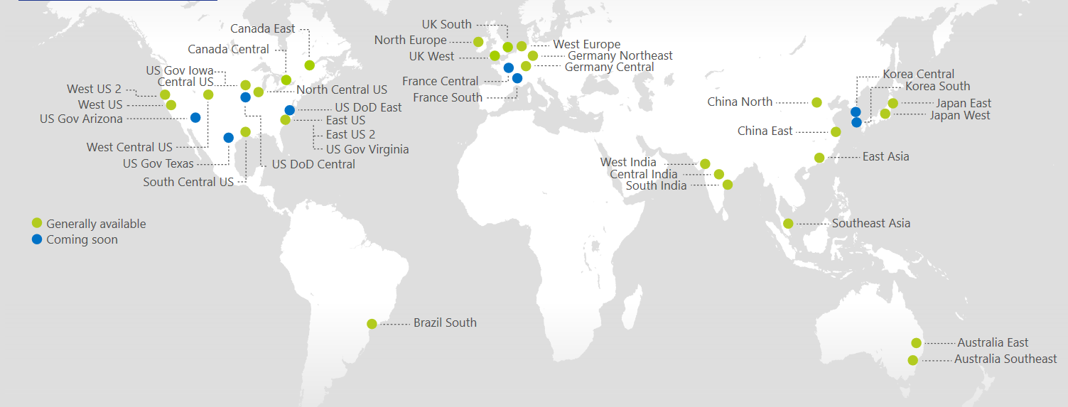
Azure Regions
https://azure.microsoft.com/regions/
Azure is generally available in 30 regions around the world, and has announced plans for 8 additional regions
Notes:
http://azuredatacentermap.azurewebsites.net/

Slide 7
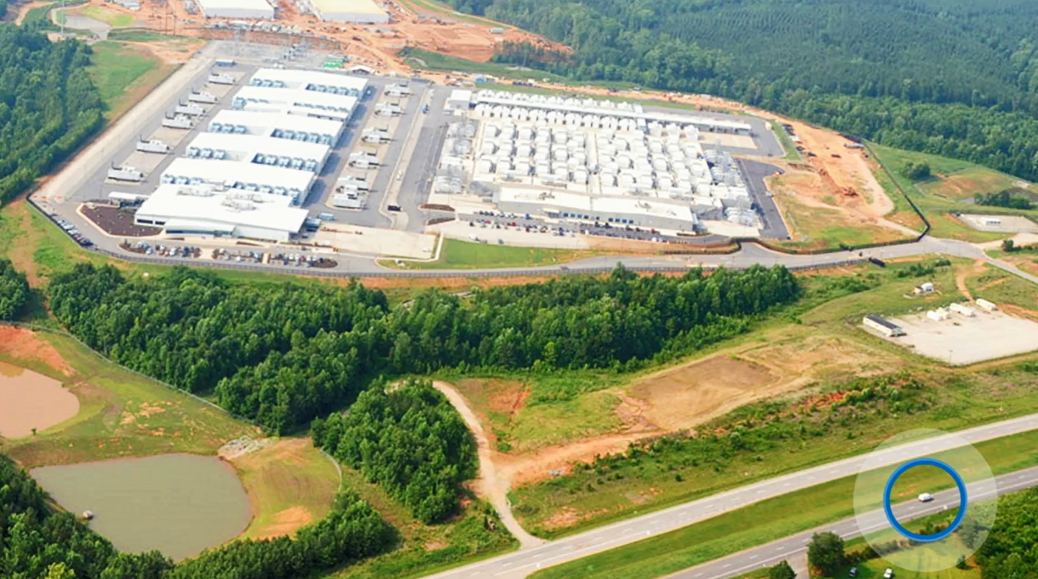

Slide 8

https://www.microsoft.com/en-gb/cloud-platform/global-datacenters
Notes:
https://www.microsoft.com/en-gb/cloud-platform/global-datacenters

Slide 9
Azure StorSimple
Azure in Open
Azure Government
Azure SQL Database
Rights Management (RMS)
Azure API Management
Azure Site Recovery
Azure Automation
Instance Level Public Ips
Azure Redis Cache
Azure Batch
Azure Marketplace
Azure Data Factory
Stream Analytics
Event Hubs
Operational Insights
Premium Storage
Virtual Machine Converter 3.0
Cloud Platform System (CPS)
Antimalware for Cloud Services and VMs
Identity Manager vNext
Analytics Platform System (APS)
Visual Studio Community 2013
Visual studio 2015 Preview
.NET 2015
Azure RemoteApp
Azure AD Basic
SSD-based instances for Microsoft Azure VMs and Cloud Services
Azure SQL Database Auditing
Live Channels for Azure Media Services
AAD Application Proxy
New experiences in Power BI
Azure DocumentDB
Azure Search
HDInsight for Storm Public Preview & GA
Azure Zone Redundant Storage
HDInsight for Hbase
WSSC vNext tech preview
Content Protection pub preview
Intune - Nov update and Dec update
Azure AAD premium features
Multi-Factor Auth enhancements
Cloudera and Hortonworks on clustered Azure VMs
Azure Instance level IP
Azure Role Based Access Controls
VPN support pub preview
TiP Testing pub preview
Azure AD Workday A148 Integration
Azure Standard SSG
ExpressRoute S2S, P2S GA
Azure Multiple NICs
Azure Networking Appliances
Azure Traffic Manager Nested policies
Azure VM Image Gallery expansion
Azure Vnet
Azure Web Jobs
VSO datacenter expansion
VSO REST Hooks pub preview
Australia datacenter
Forced Tunneling
WSSC Azure Packs
Azure G-Serves Instances
Azure Key Vault
Drivers for SQL Server
MDM for Office 365 public preview and GA
Azure Media Services Content Protection
Azure Mobile Engagement
Node.js Tools for Visual Studio
Visual Studio 2013 updates
Auto-HA for SQL Server VM
Auto-Patching and Backup for SQL Server VMs
Azure SQL Database Increased Compatibility
Azure AD Connect Health pub preview
Azure AD MFA Per App / Conditional access pub preview
Azure RMS controlled user deployment
Azure RMS departmental templates pub preview
Azure Site Recovery SAN Replication
ASP.NET 5 Preview
Azure SDK 2.5.1
Team Foundation Server 2015 preview
Azure Machine Learning GA
Azure HDInsight for Linux Pub Preview
Azure HDInsight Support for Hadoop 2.6 pub preview
Azure SQL Database security feature - Data Masking pub preview
Azure SQL Database security features - Encryption
Azure SQL Database security features - Row Level security
Azure AD: API for SIEM
Microsoft Intune monthly updates
Remote Desktop Client for Windows Phone 8.1
Azure App Service
Azure CDN Integration
Azure Media Encoder Premium
Azure AD Premium & Basic in CSP
Azure IoT Suite
Windows Server Containers
Hyper-V Containers
Windows Server Nano Server
Azure Media Player GA
Azure Service Fabric
Azure IoT Suite
Azure Site Recovery: Protect VMWare and Physical Servers in Public Preview
Azure Backup Generally Available
Azure API Management Premium simplifies high availability and massive scale for APIs
ExpressRoute for Office 365
Azure Active Directory Dynamic Membership For Groups
Automatic Password Change for Social Media Shared Accounts
Compute-Intensive A10 and A11 Virtual Machine Instances
Remote Desktop app for Windows Phone support for Gateway and Remote Resources
Informatica Cloud Agent availability in Linux and Windows Virtual Machines
Azure DocumentDB Hadoop Connector
Azure HDInsight support for more VM sizes
Enterprise-Grade Array-Based Replication and Disaster Recovery with ASR and System Center GA
500+
New releases in
the last 12 months
Notes:
112

Slide 10
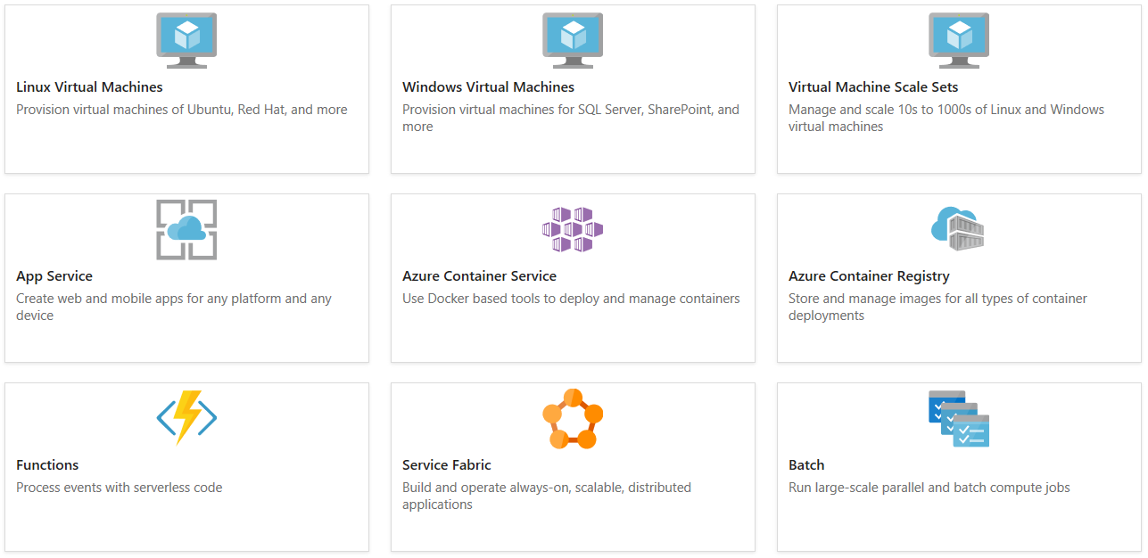
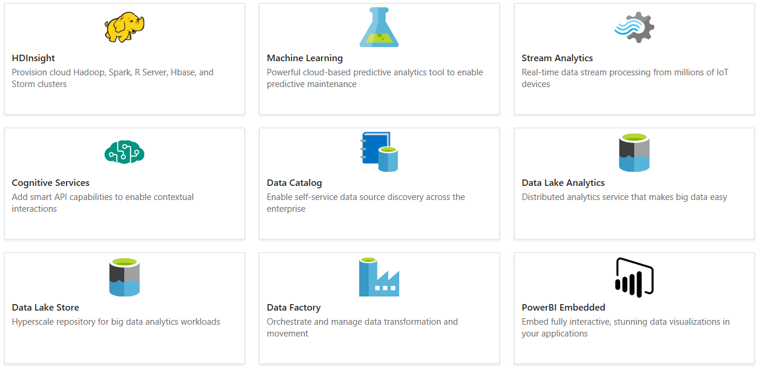
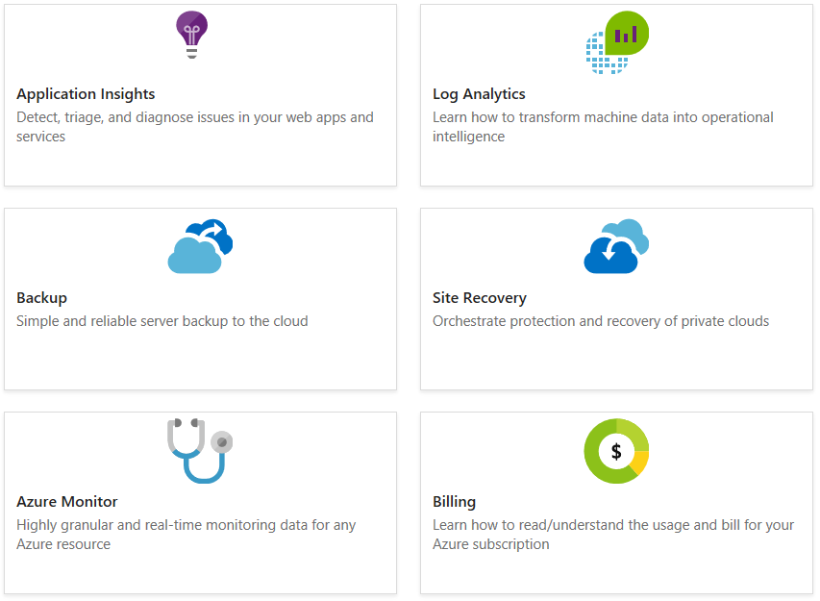
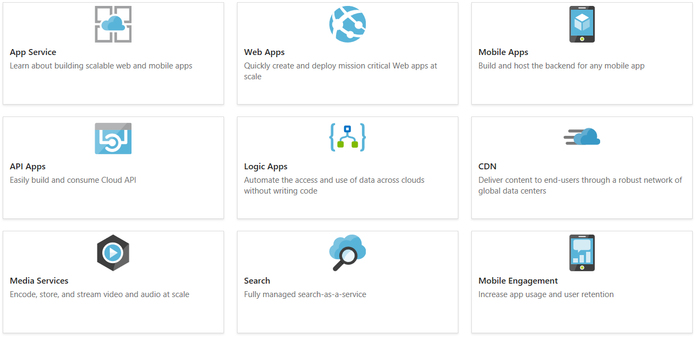
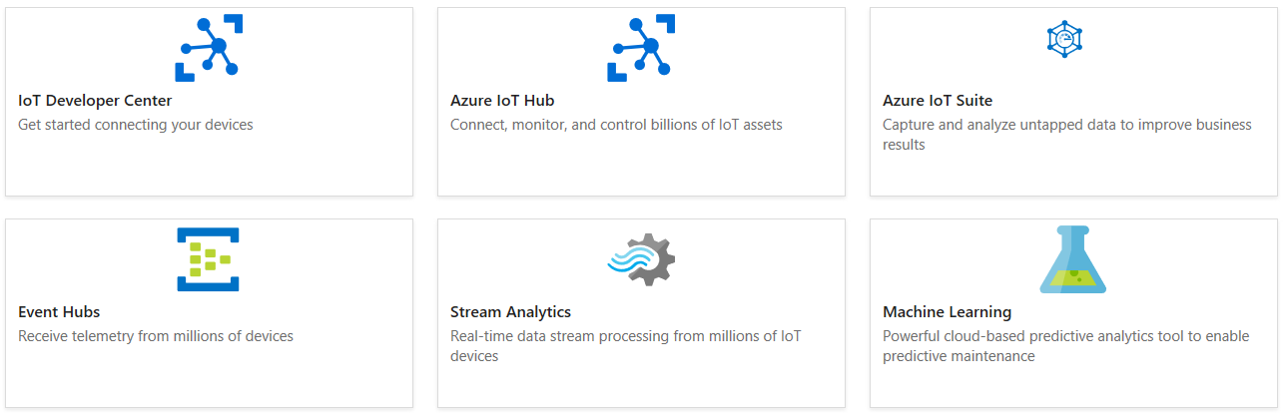
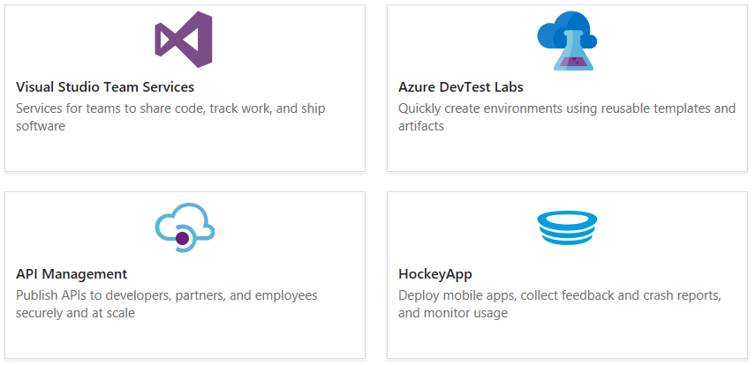
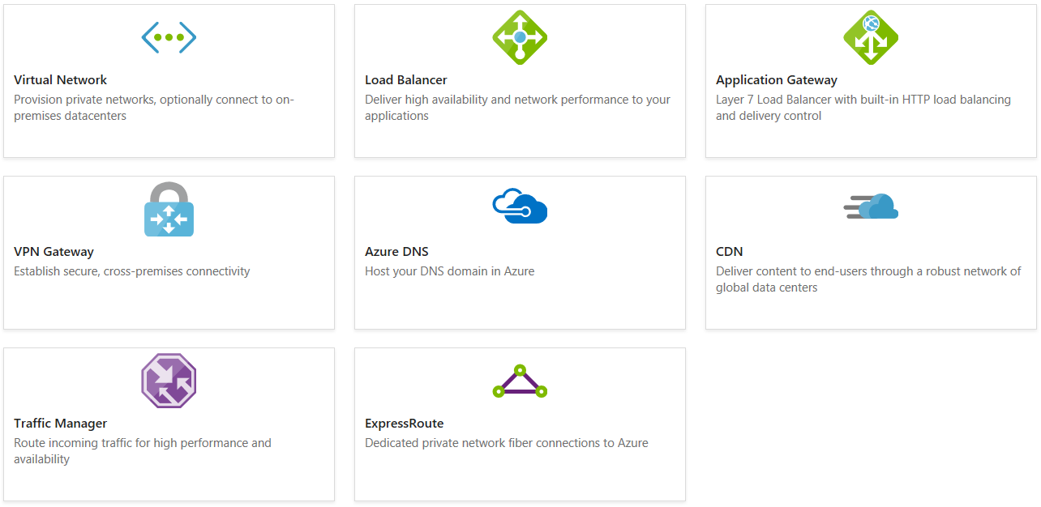
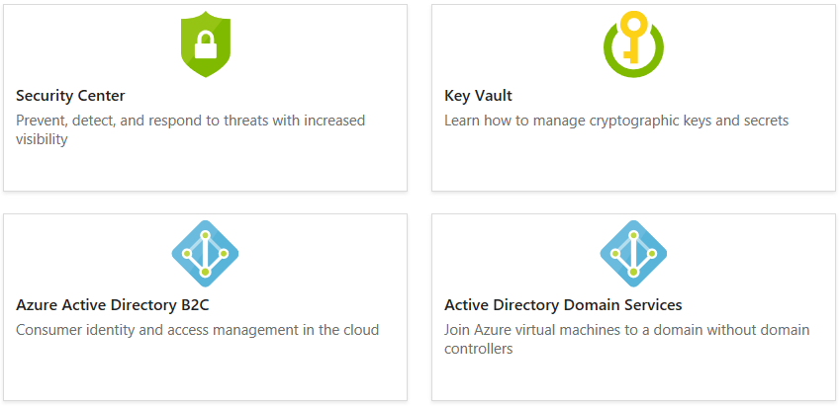
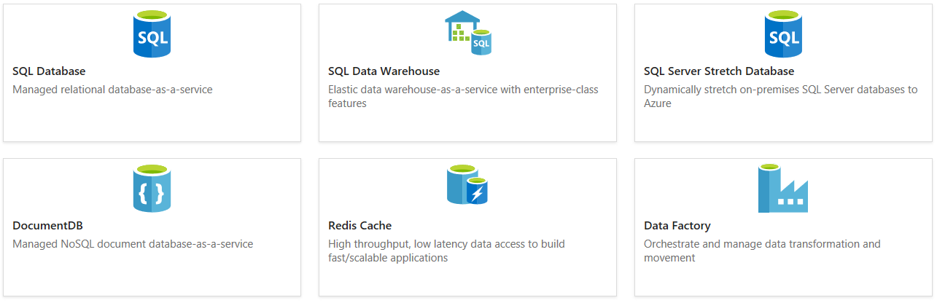
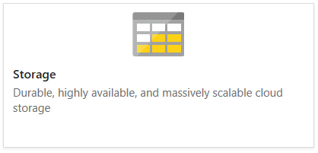
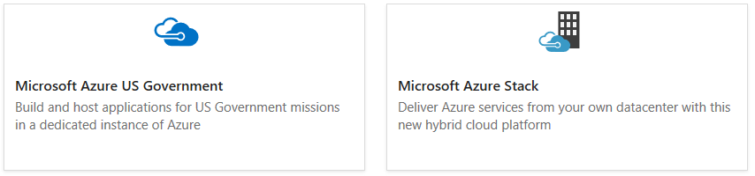
https://docs.microsoft.com/azure/

Slide 11
